Slide 1

Case Study Koodoo’s AI Call Center
Applicant Name : Karthick Sundar Coimbatore Krishnaraaj
Submission date : 02/04/2024
Duration : 7 days

Slide 2
Agenda
Problem statement
Exploratory Data Analysis (EDA) & Pre-processing
Approach & Design
Demo
Conclusion & Future work

Slide 3
Problem Statement

Slide 4
Background & objectives
Koodoo is at forefront in revolutionizing the mortgage industry trying to streamline the mortgage process with cutting-edge AI-driven solutions
The idea is to solve the challenges in analyzing the customer-agent call center recording for variety of purposes including, agent performance, customer problems, sentiment etc.
The challenge is to,
Classify the customer-agent speech, which is a speaker diarisation problem
Verification of agent reading the disclaimer content in the call
Identify the sentiment distribution in the call
Generate a concise summary of the entire call recording with some actionable insights

Slide 5
Exploratory Data Analysis & Pre-processing

Slide 6

Data Understanding
Data type: Audio files
Format: .mp3
Data size: # 3 files
Usage: To test and validate the app
Speakers: Customer-Agent
Context: Call center for postal service
Audio 1:
Customer complaint on delayed parcel delivery
Audio 2:
Customer complaint on stolen parcel
Audio 3:
Customer enquiry on parcel service from Shanghai to London

Slide 7
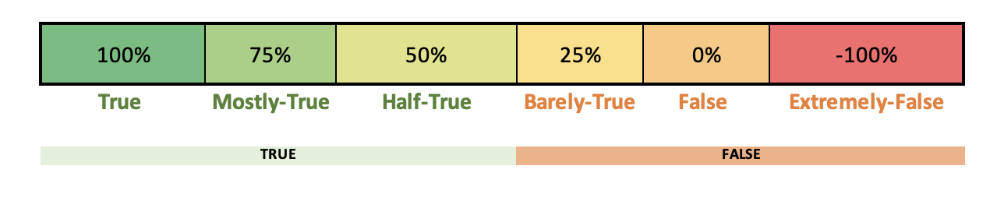
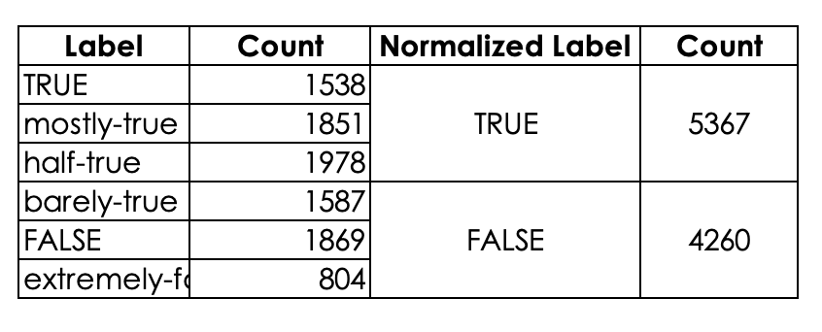
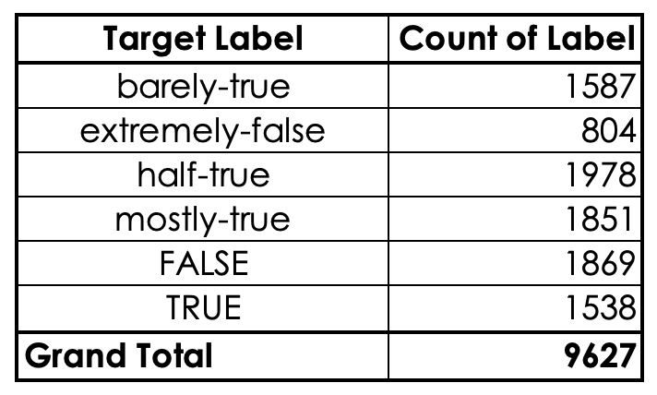
Target Label & its Normalization
Although the target label has 6 different levels of truthfulness, the challenge expects the output of the python package to be in 2 levels - TRUE and/or FALSE
Actual target label distribution
Normalized target label distribution

Slide 8
Multi-label binarizing – subject column
Subject column is a multi-label categorical variable adding the category of the statement
There are 144 unique subject tags mentioned in the data
Education$Message-machine$taxes
Split by “$”
Education
Message-machine
taxes
Multi-label binarizer
religion
Education
Message-machine
taxes
Military …..
0 1 1 1 0 ….

Slide 9
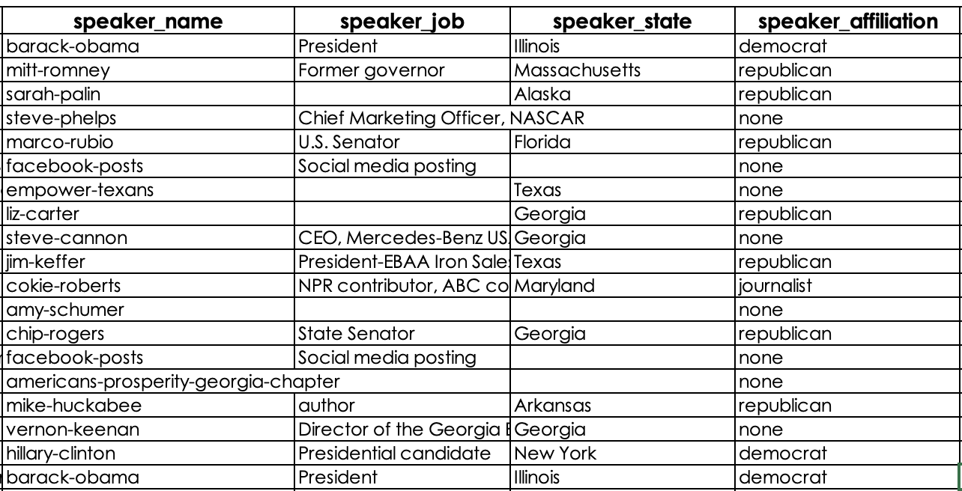
One-hot encoding of categorical columns
All the categorical columns does not contain any ordering by nature and hence one-hot encoding is opted over label-encoding
Barack-obama
One-Hot Encoder
0 1 0 0 0 ….
democrat
One-Hot Encoder
1 0 0 0 0 ….
President
One-Hot Encoder
0 0 1 0 0 ….
Ilinois
One-Hot Encoder
0 1 0 0 0 ….

Slide 10
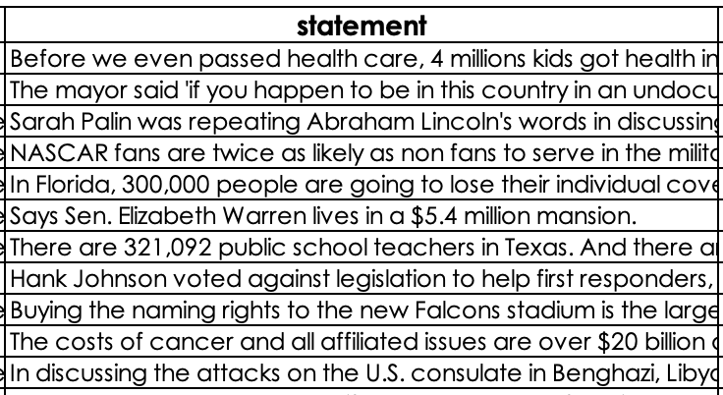
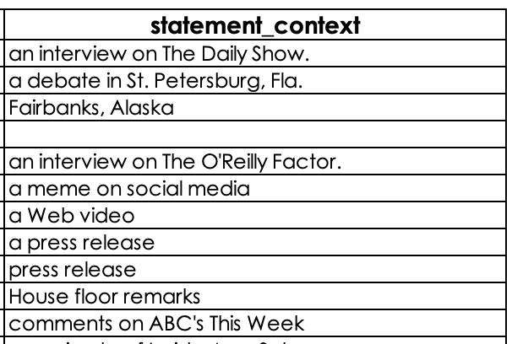
Text column vectorizing
Text column is converted to vectors by TF-IDF method, which overcomes lot of shortcoming of count vectorizer or bag or words
Before we even passed health care….
Tf-Idf vectorizer
0.345 0.005 0 .12 0 0.44 ….
An interview on The Daily Show
Tf-Idf vectorizer
0 0 0.66 0.11 0 ….

Slide 11
Approach & Design

Slide 12



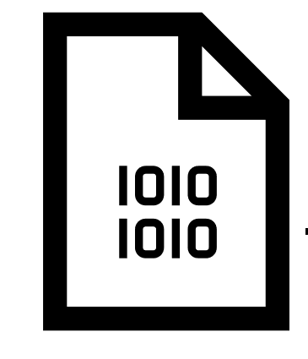

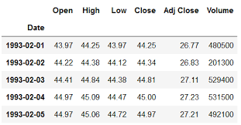

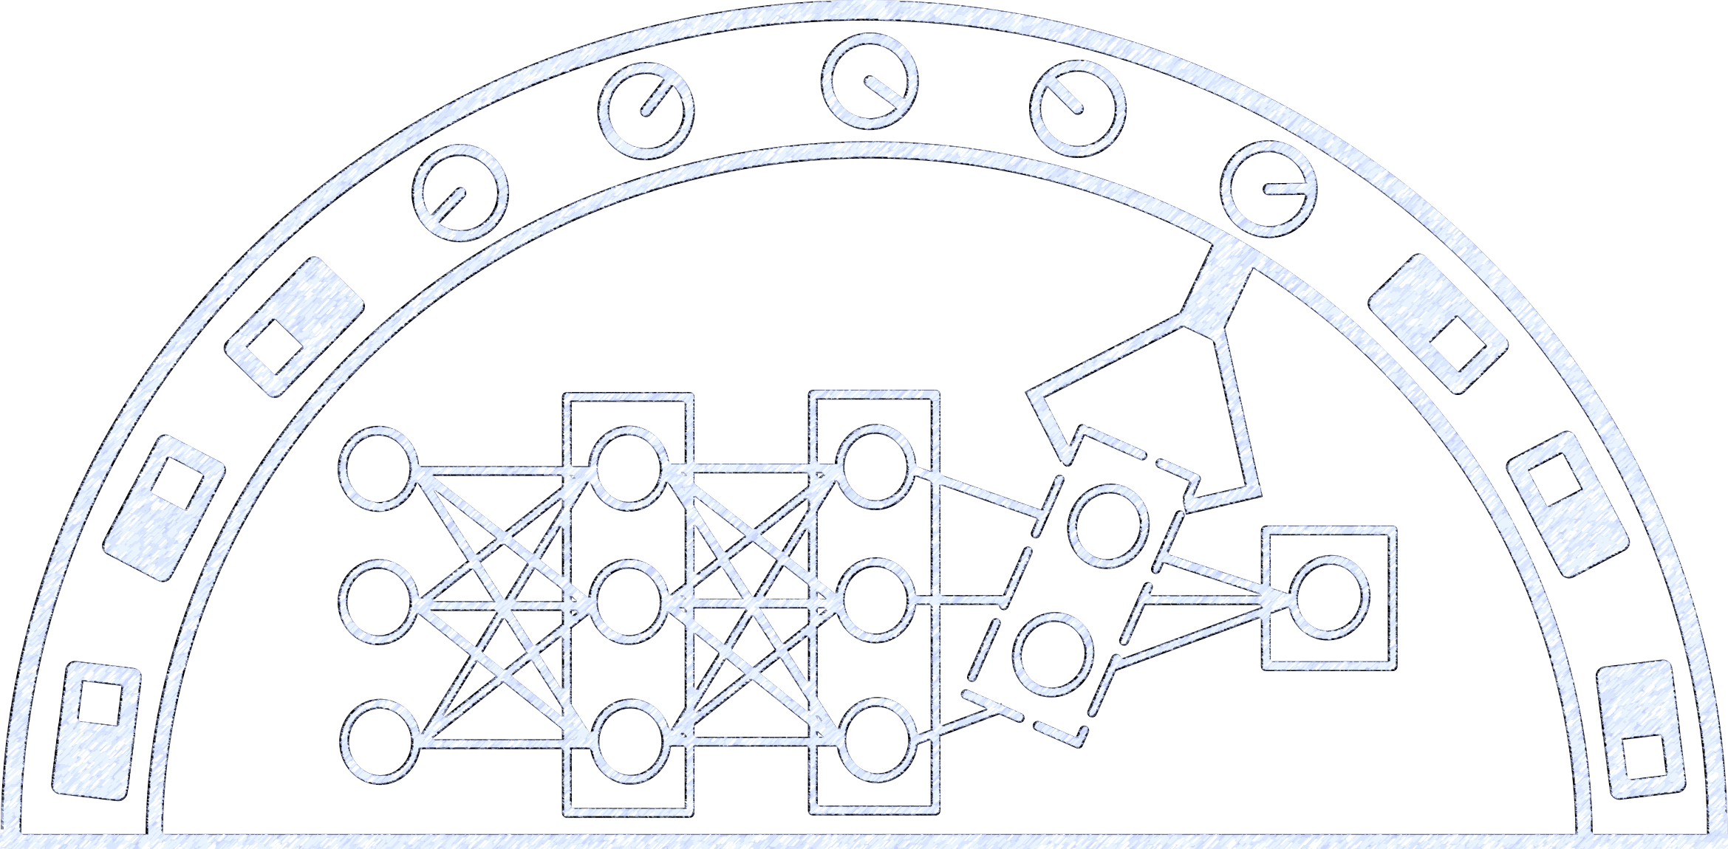
User flow for ‘TruthPredict’ package
Installation & input feed
Training
Model files
Prediction
TruthPredict
Data cleaning & Processing
ML algorithms
User test input (json)
Stage 1
Stage 2
Stage 3
Stage 4

Slide 13


Design for ‘TruthPredict’ – Stage 1
Python code + Requirement files
Add init file and build a package
Build wheel to python package
User installation

Slide 14
Design for ‘TruthPredict’– Stage 2
The problem statement is treated as a binary classification, since the target variable chosen is TRUE/FALSE
List of pre-processing steps to convert text to numeric vector format are
Categorical variables – there is no natural ordering in the variables so -> one-hot encoding
2. Text variables:
Tokenize text
Remove punctuation
Remove stop-words
Lemmatization
Remove numbers
Expanding contractions
TF-IDF vectorizer
The data is split into Train-test split: 66.66% for training and 33.33% for test

Slide 15

Design for FinAutoML – Stage 3
Data Preparation
Decision Tree
Model performance summary
Installation & input feed
Naïve Bayes
Tokenization
Random Forest
Remove punctuations
Data frame
User request
Python Package
Remove stop-words
XGBoost
+
Model files
Remove numbers
Ensemble
Stage 1
Stage 2
Contraction fix
Lemmatization

Slide 16
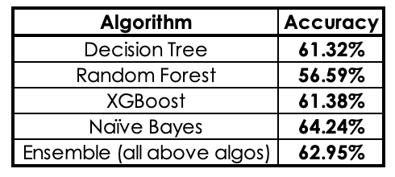
Design for ‘TruthPredict’– Stage 3
List of classification algorithms are experimented
Grid-Search is implemented in-order to pick up best hyperparameters for every model built
Cross-validation is employed to avoid restricting the performance measure to one single split
Algorithms implemented and their accuracy scores are listed below
Note: Advanced embedding and DNN algorithms can be experimented to see more incremental change in the accuracy

Slide 17
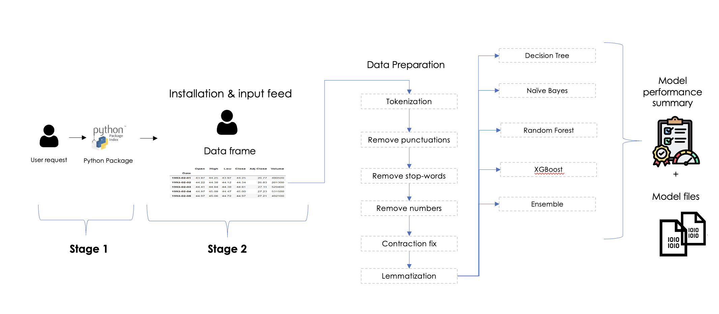
Design for FinAutoML – Stage 4
Prediction TRUE/FALSE
+ Reasoning
Best model selection
Stage 3
User test input (JSON)

Slide 18
Design for ‘TruthPredict’– Stage 4
The user test input is received in JSON format
The JSON input is then restructured to data-frame format, and then passed on to data prep class to be cleaned, encoded and vectorized
All the previously built models, during training phase are evaluated on their performance metric and the best model is chosen with highest accuracy
Now the selected model is used to predict the outcome and the result is sent to infer the reasoning
The reasoning is structured as a sentence using the feature importance and template filing strategy

Slide 19
Explainability of predictions
SHAP (Shapely Additive exPlanations) method is used to explaining the output of the models
SHAP force plot is adopted in case of understanding the contribution of text words to the final prediction of the classifier
Words with positive SHAP value contribute to “TRUE” label and words with negative SHAP value contribute to “FALSE” label
LIME is also an alternative to the SHAP library which can be used interchangeably for the same purpose
To generate explanation for average user with no tech background,
Approach 1: To generate a template with placeholder for each attribute and explain the similarity with SHAP force plot values for each word how much they contribute to output
Approach 2: Get the attention layer from the sequence model and allow a generative model to explain the importance attribution to output prediction

Slide 20
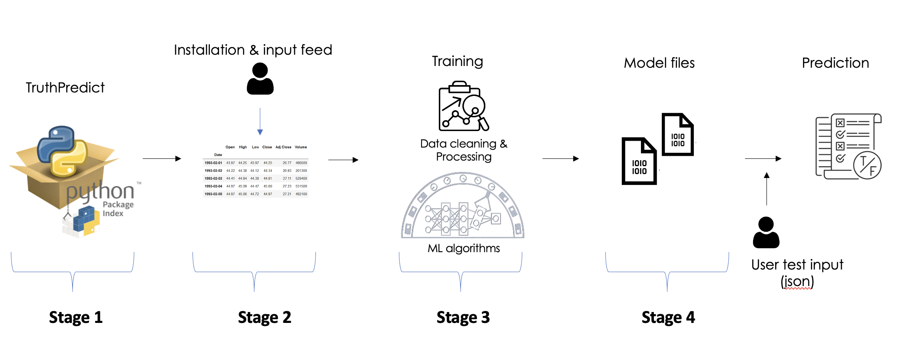

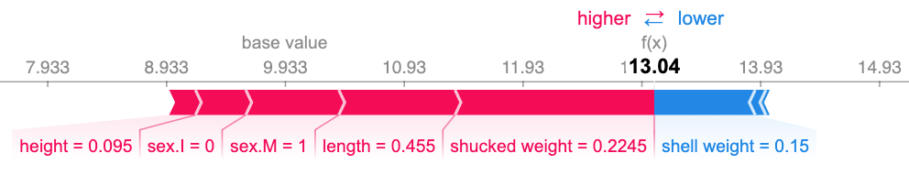
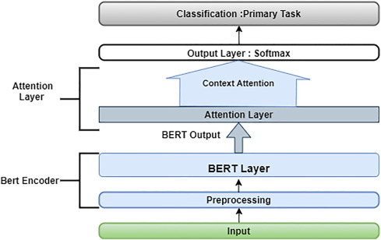
Explainability of predictions
Approach 1 :
'The statement made is predicted to {model_prediction}. Because it resonates with the similar {model_prediction} statements made by the people associated with {speaker_affiliation}. Also to note that {speaker_name}, serve as evidence from past that, through their similar TRUE statements. '
Sort values based on importance and tag them under their data column
Prediction
Approach 2 :
Prediction
Attention layer feature importance
LLM
'The statement made is predicted TRUE because of the following reasons….
DNN model
Note: The above is my proposed plan to be implemented as part of the solution, could not fully explore it due to time constraint, but could be taken up as future work extension

Slide 21




Programming tools
Microsoft Excel
Presentation
Python
Python Machine learning library

Slide 22
Potential computing resources
Local machine configuration (Dev/Test):
OS: Mac OS Monterey
Processor: M1
RAM: 16GB
Storage: 250GB
Free cloud computation (Dev/Test):
Google Collaboratory
CPU, GPU and TPU support
Subject to availability
Cloud computation (Dev/Test/Deploy):
Amazon EC2 instances based on required
Cost as per AWS pricing
Will opt for this only in case of big data not handled by previous two options

Slide 23
Demo

Slide 24
Conclusion

Slide 25

Conclusion & Future Works
Packaged python solution
Text and categorical merge
Automated gridsearchCV & best model evaluation for inference
Flexible usage with very minimal code for user-end
Flexible to update and expand the package
Pre-processing:
GLOVE
Word2Vec
Fasttext
ELMO etc
Modelling:
ANN
Advanced language models pre-trained
Transfer learning on pre-trained language models
Containerization & deployment:
Making it easy to move and deploy in different OS and environment without customization
Deployment of the solution as API end point services on cloud
Explainability:
Template based with LIME
Sequence models with attention layer to understand the feature importance

Slide 26
Thank you

